Slide 1
Inn at the Village
DZA 13-001, VTTM 13-002, UPA 13-003, & DR 13-003
Town Council
Public Hearing
November 19, 2014

Slide 2
Introduction

Slide 3
Public Hearing Purpose
Council to consider the Planning & Economic Development Commission’s recommendation to:
  Certify the Subsequent Environmental Impact Report
  Approve the Inn at the Village amendment to the North Village Specific Plan (district zoning amendment)
  Approve the Inn at the Village tentative tract map, use permit, and design review permit

Slide 4
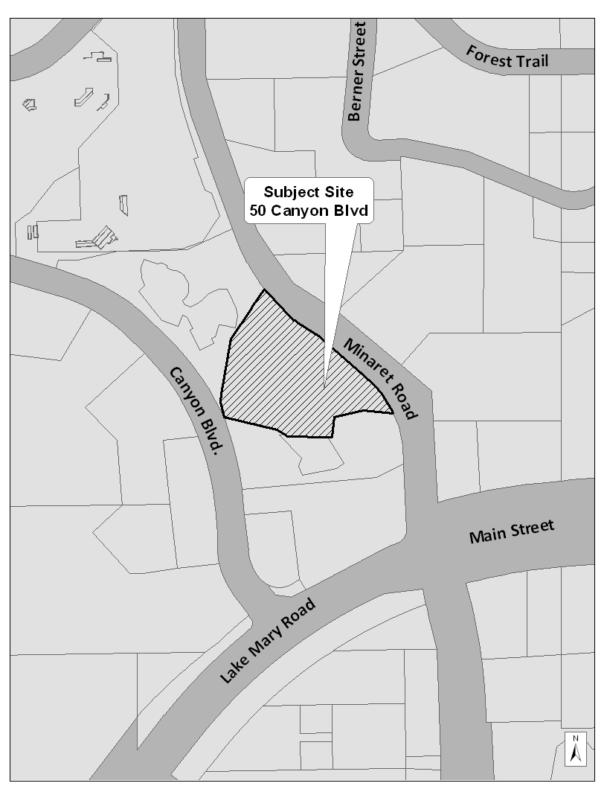
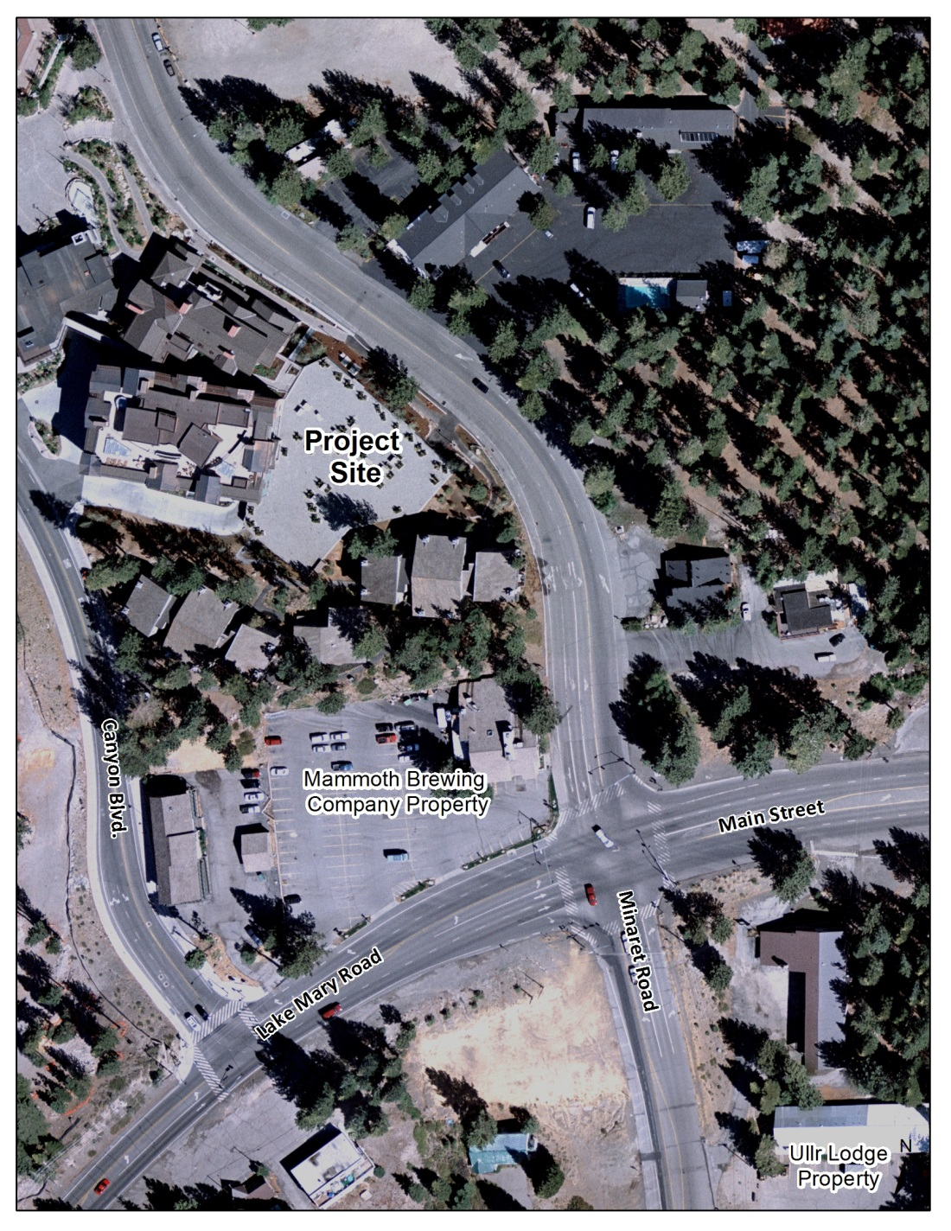
Project Site Maps

Slide 5
Background & Project History
8050 project approved in 2005
  Buildings 8050A, B & C
  49-unit fractional ownership private residence club
  Maximum height of 62 feet
  8050A, 8050B, and parking garage have been built
Inn at the Village (“Inn”) is a redesign of the unbuilt 8050C building
Original Inn proposal for a 94-foot tall hotel with up to 73 rooms was revised after Commission and Advisory Design Panel review

Slide 6
Proposed Project
7-story hotel with up to 67 rooms
  Double-loaded corridor, 520s.f. standardized rooms
  Maximum height of 80 feet with an additional 4.5 feet for roof appurtenances
Pool & jacuzzi terrace (~4,600s.f.) – southwest exposure
Food & beverage service
Spa
Minaret Road streetscape features
  Pedestrian porte-cochere
  Pocket park (~530s.f.) – paving, benches beneath a pergola
  Informational kiosk (~370s.f.) – visitor information or limited concessions
  Food and beverage terrace
  Permanent heat traced sidewalk
  Landscaping
  Widened shoulder for emergency vehicle access

Slide 7
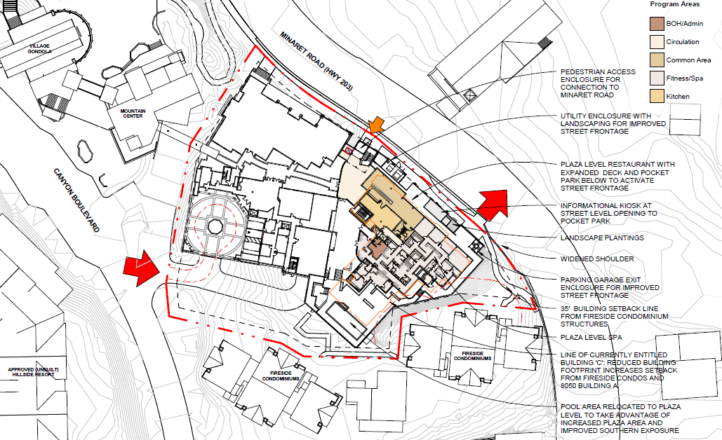
Site Strategy, Sheet 3-10

Slide 8
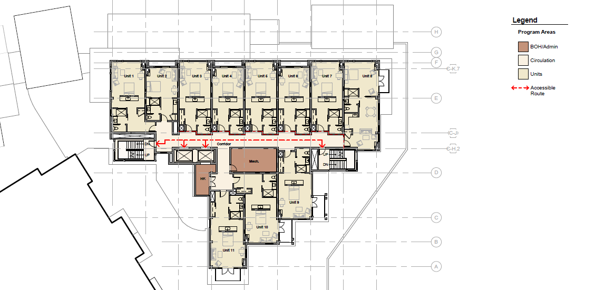
Typical Hotel Level Plan, Sheet A2.40

Slide 9
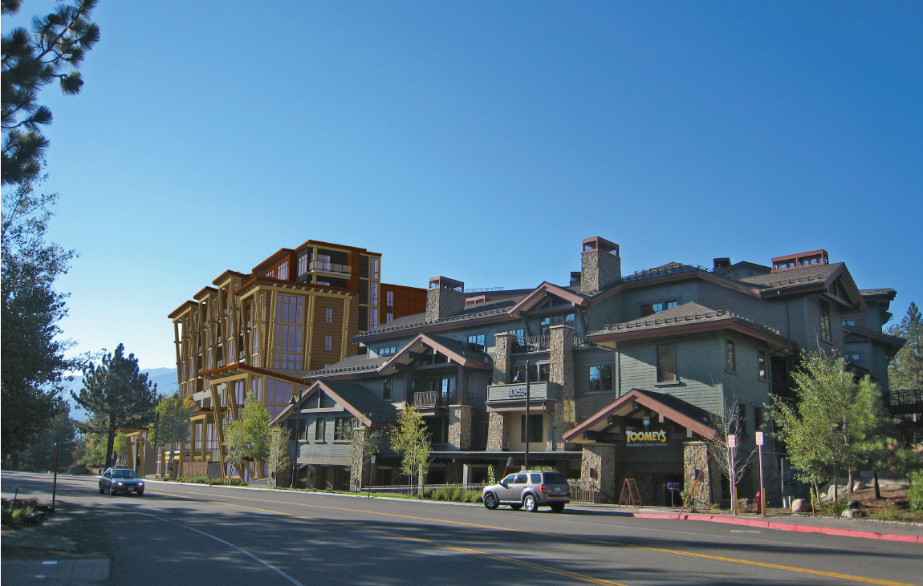
Color Perspective Representation, Sheet 17-3
Notes:
View from ~ Berger’s

Slide 10
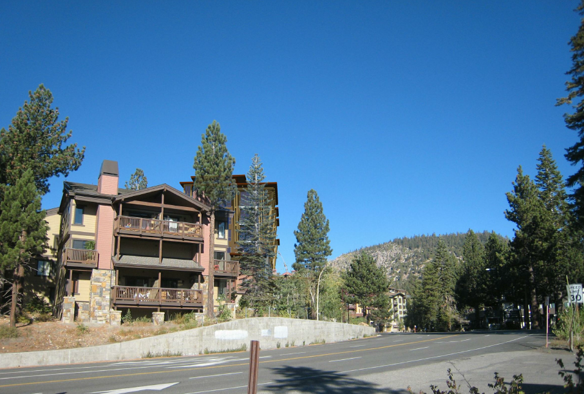
Photosimulation from Main St/Minaret Rd

Slide 11
Discussion Format
Applicant Presentation
Subsequent EIR
  Analysis of potential environmental impacts (aesthetics – views, shade/shadow, traffic, noise, etc.) pursuant to CEQA
NVSP Amendment (District Zoning Amendment)
  Height (80 feet + 4.5 feet for appurtenances)
  Minaret Road setback (pedestrian entry overhang and heights above 55ft)
  Density (30 rooms over allowable site density)
Tentative Tract Map, Use Permit, and Design Review
  Subdivide airspace
  Allow hotel use
  Site and building design (parking, deliveries)
Council deliberates, makes motion(s), and votes
Notes:
Describe to help direct public comments
Prompt Andy re make motion at end after all testimony has been given to make an informed decision

Slide 12
Certification of Subsequent EIR

Slide 13
Environmental Analysis
Modified Initial Study
  30-day public review 3/26/14 – 4/24/14
  Public Scoping Meeting 4/9/14
Draft Subsequent Environmental Impact Report (SEIR)
  45-day public review 7/8/14 – 8/22/14
  Public Comment Workshop 8/13/14
Final Subsequent Environmental Impact Report (SEIR)
  Available to the public 9/23/14
Environmental analysis required by State law, California Environmental Quality Act (CEQA)
As encouraged by CEQA, analysis tiers off of the 1999 Subsequent Program Environmental Impact Report (SPEIR) for the North Village Specific Plan Amendment
  Focus on new potential impacts not considered in the 1999 SPEIR
  Incorporate applicable 1999 SPEIR mitigation measures

Slide 14
Draft SEIR
  Topics evaluated:
    Land Use and Relevant Planning
    Aesthetics/Light and Glare
    Traffic/Circulation
    Noise
    Air Quality
    Greenhouse Gas Emissions
    Utilities and Service Systems
  No significant and unavoidable impacts with the incorporation of regulations and mitigation measures
  Alternatives
    No project/no development - no new development
    No project/reasonably foreseeable development - 8050C as approved
    Reduced height alternative – 58 foot tall condo-hotel with 56 rooms; amenities and streetscape enhancements reduced or eliminated
  Alternatives would not attain most of the Town’s goals and objectives

Slide 15
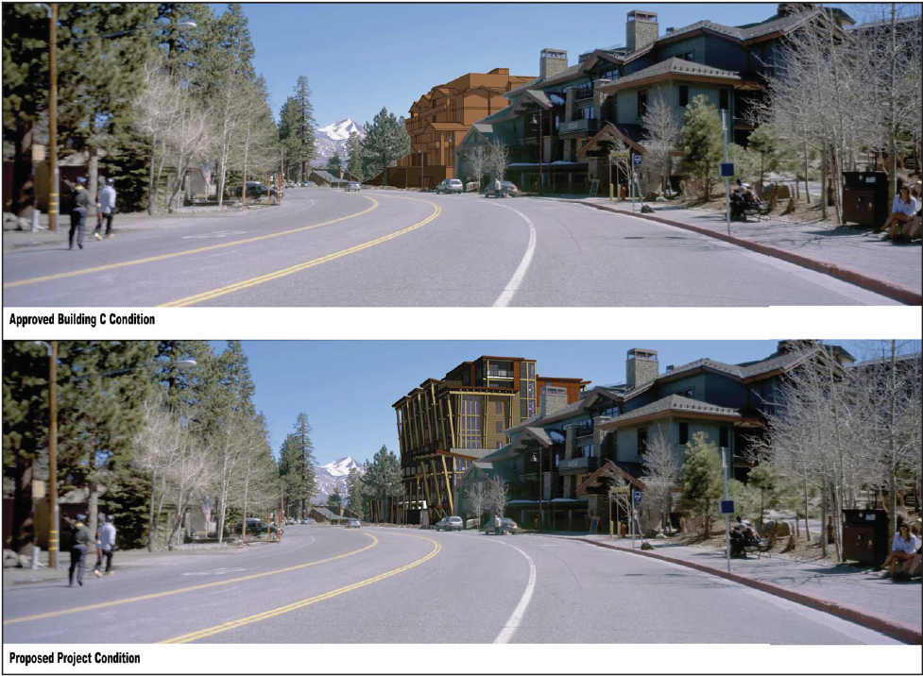
Key View 1 – Proposed Condition, DSEIR Exhibit 5.2-6

Slide 16
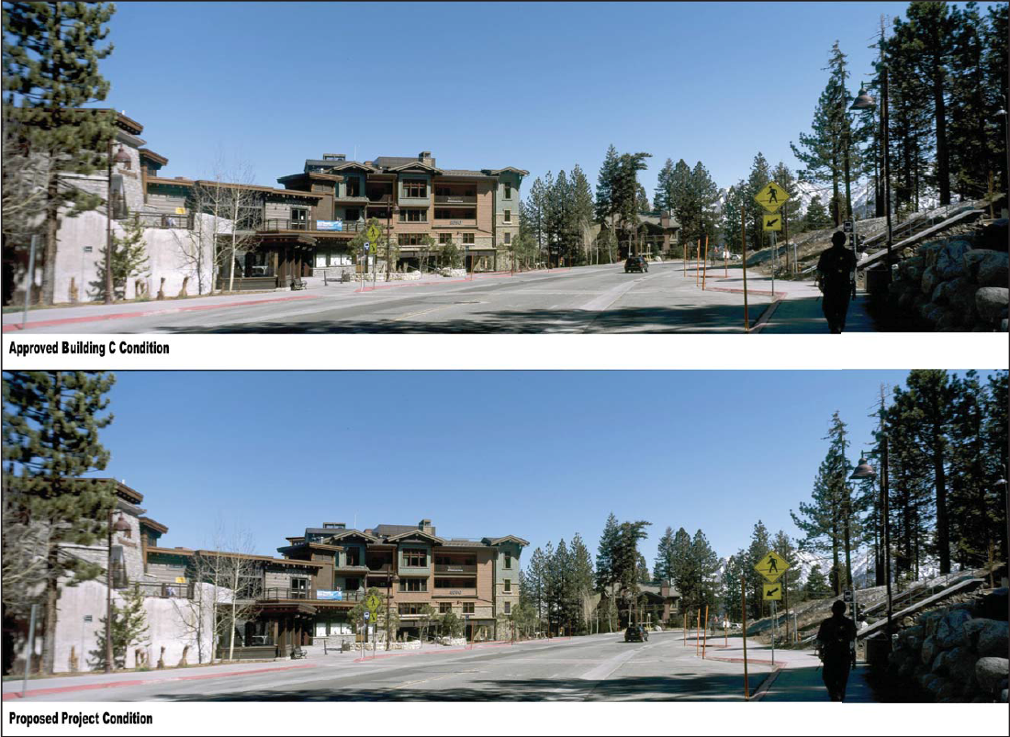
Key View 2 – Proposed Condition, DSEIR Exhibit 5.2-7

Slide 17
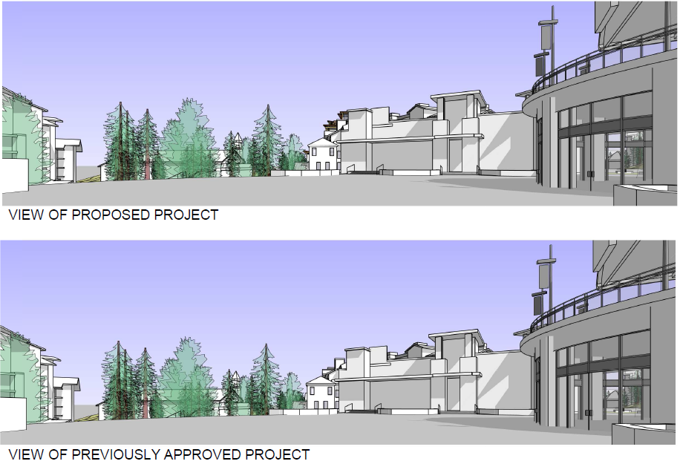
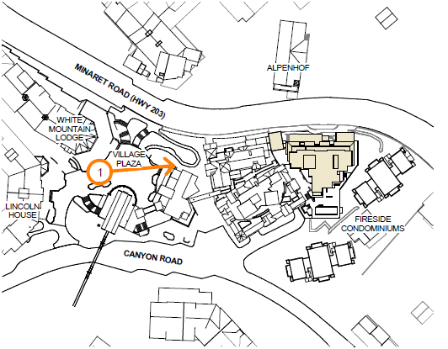
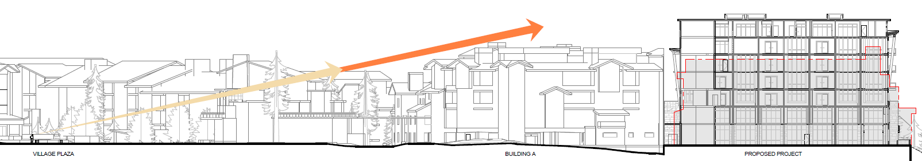
View Analysis – Village Plaza, Sheet HA 1

Slide 18
Private Views not Protected
General Plan and Municipal Code protect public views, not private views
Public views are those from publicly-accessible vantage points (e.g., streets, sidewalks, public spaces)
Subsequent EIR analyzes public views only
No findings related to private views required

Slide 19
Shade/Shadow
Increased shading of portions of Minaret Rd and properties on the east side of Minaret Rd for a few additional hours during winter
Determined to be a less than significant impact because:
  Caltrans conducts snow removal and cindering operations; portions of Minaret Rd already shaded; no new unmanageable conditions
  Snow melt systems in existing and future sidewalks; BAD maintains and hauls snow off-site as needed
  Existing buildings and trees cast shadows on Minaret Rd and properties on the east side of Minaret Rd in winter
  Uses on the east side of Minaret Rd are not considered “shadow-sensitive”

Slide 20
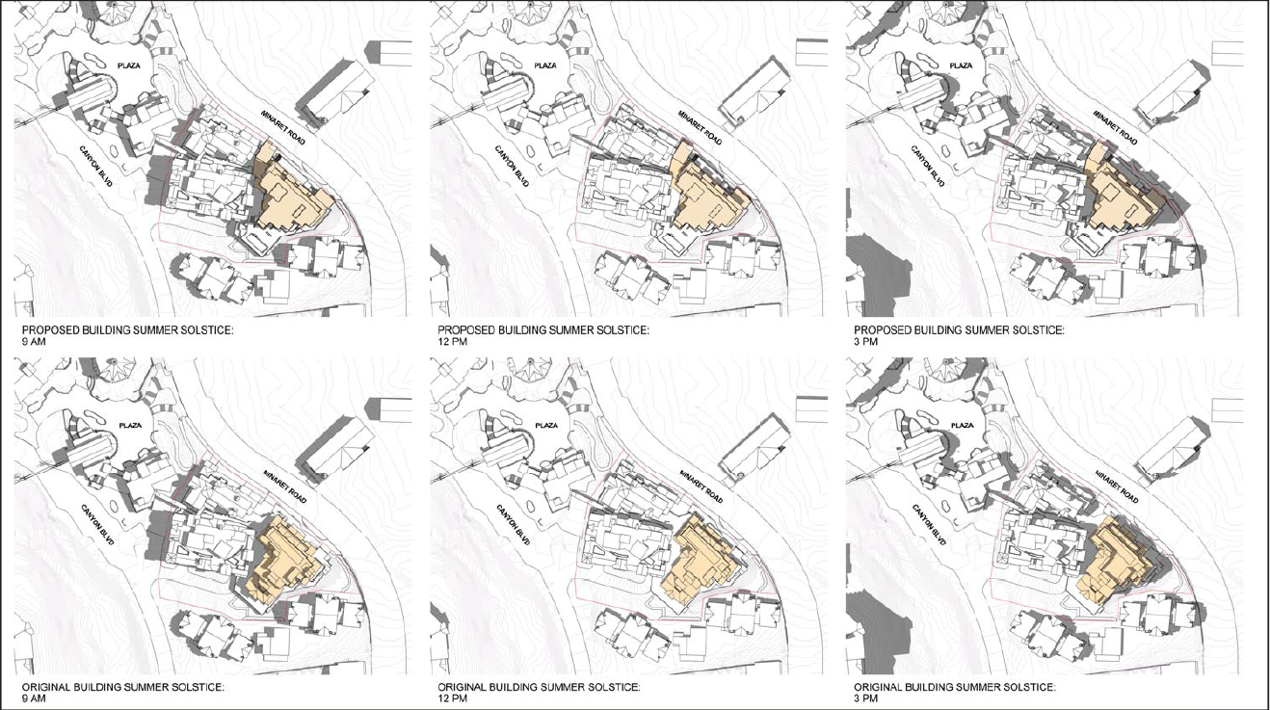
Proposed Summer Shadow Patterns
DSEIR Exhibit 5.2-9c
Notes:
DSEIR page 5.2-32

Slide 21
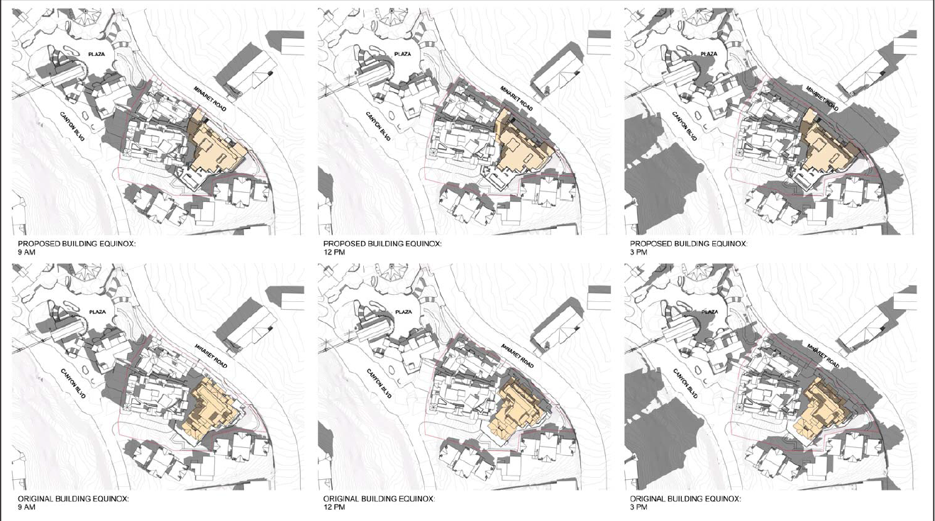
Proposed Vernal/Autumnal Shadow Patterns
DSEIR Exhibit 5.2-9c
Notes:
DSEIR page 5.2-34; Note 8050B and Fireside shadows

Slide 22
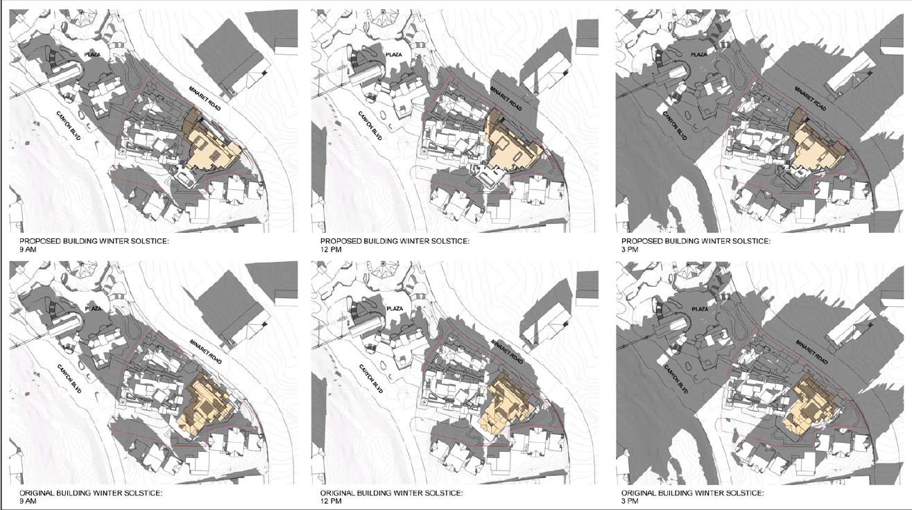
Proposed Winter Shadow Patterns
DSEIR Exhibit 5.2-9b
Notes:
DSEIR page 5.2-33; No change in Minaret Rd shading at 3pm; this only reflects sunny days

Slide 23
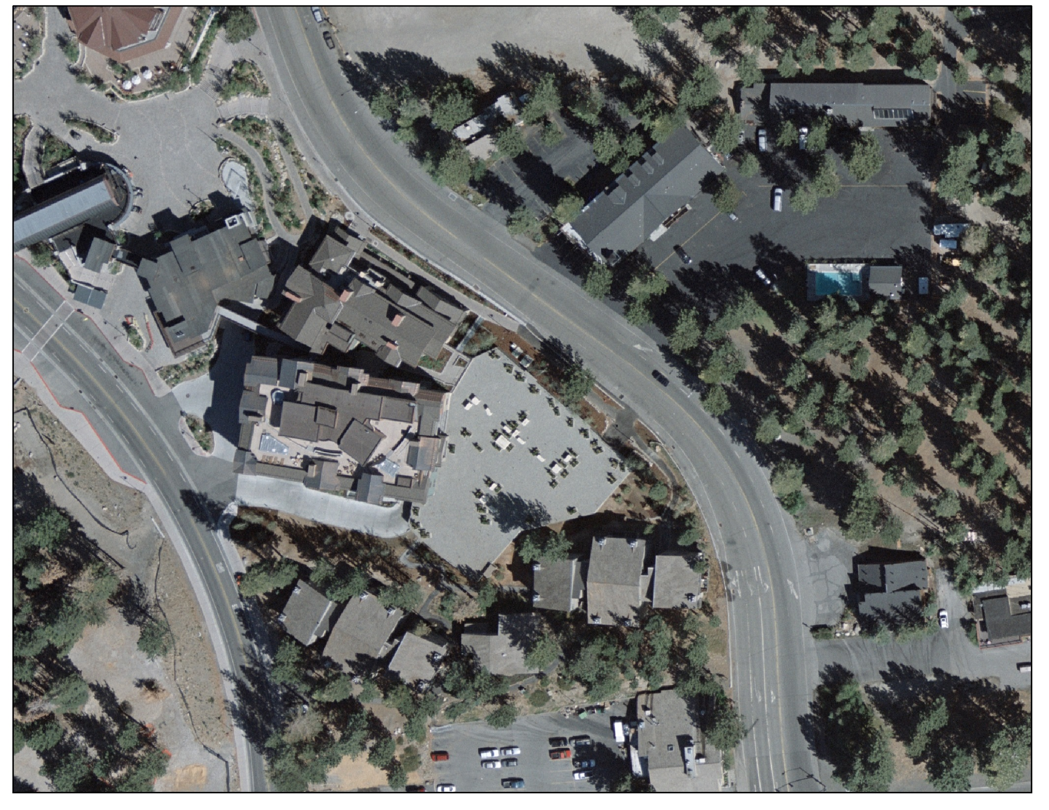

Slide 24
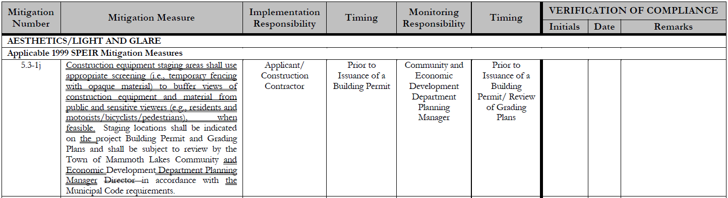
Final SEIR
Responses to comments on the Draft SEIR
Errata
Conclusion of Draft SEIR unchanged
Mitigation Monitoring and Reporting Program (MMRP)

Slide 25
CEQA Findings
SEIR completed in compliance with CEQA
  All CEQA requirements, including public review periods and content of EIR, have been adhered to
SEIR presented to and considered by the Town’s decision-making body
  SEIR presented and considered tonight
SEIR reflects the Town’s independent judgment and analysis
  Town reviewed and approved all documents prepared by EIR Consultant
Mitigation measures incorporated to lessen all potential environmental impacts to less than significant
  Previously adopted and new mitigation measures incorporated; no significant impacts
Mitigation measures identified in the Mitigation Monitoring and Reporting Program
  Final SEIR, Section 4.0
The record of proceedings is with the Town Clerk at the Town Offices
  Clerk has record of proceedings

Slide 26
NVSP Amendment (DZA 13-001)

Slide 27
Proposed NVSP Amendment (DZA 13-001)
Height
  Maximum projected height allowed – 50 feet
  Maximum height allowed with substantial housing – 62 feet
  Roof appurtenances allowed – 3 feet
  Height requested – 80 feet + 4.5 feet for roof appurtenances
  Exceeds approved 8050C height by 18 feet
Minaret Road Setback
  Pedestrian porte-cochere roof overhang to encroach 5 feet into the 6-foot setback (only encroachment at pedestrian level is this overhang)
  Building heights 55 feet and above to encroach 10 feet into the 40-foot setback
Density
  Density allowed – 55 rooms/acre
  Density requested – 72 rooms/acre
  30-room density transfer from Mammoth Crossing Site 1 (Mammoth Brewing Company) or Site 3 (Ullr Lodge)
  Do not count commercial space towards density (450s.f. commercial = 1 room)

Slide 28
Building Mass & Height
Building mass shifted from the rear of the site to the upper portion of the building (“taller and leaner” building)
  Accommodate outdoor pool and jacuzzi terrace
  More natural light access to rooms
  Additional separation from the Fireside Condominiums
Accommodate 1st floor commercial uses/amenities
Accommodate an efficient double-loaded corridor floor plan
Critical mass of hotel rooms and amenities accommodated

Slide 29
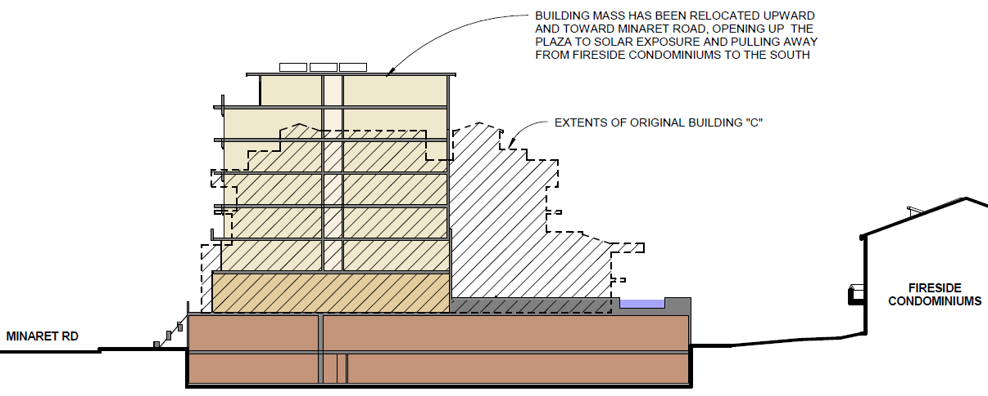
Massing Strategy, Sheet 18-3

Slide 30
Height Analysis
Mammoth Crossing Site 1 height (1.79 acres)
  17% of site up to 80 feet
  18% of site up to 70 feet
8050/Inn site height (1.83 acres)
  1% of site between 80-84.5 feet
  10% of site between 74-80 feet
  12% of site between 65-73 feet
Height would extend above the average tree canopy in the area by 5 to 13 feet; project consistent with all other General Plan Policies
Flythrough videos (Applicant can present)
35% of site 70 feet+
23% of site 65 feet+
Notes:
MXing good comp since most recent NVSP amend (excluding 94 Berner) and was approved unanimously Sept ’09; Site 1 located close to project, and Site 1 acreage
Site 1 tallest heights area elevation 8030-8040; Inn 8040-8044, pool terrace 8055

Slide 31
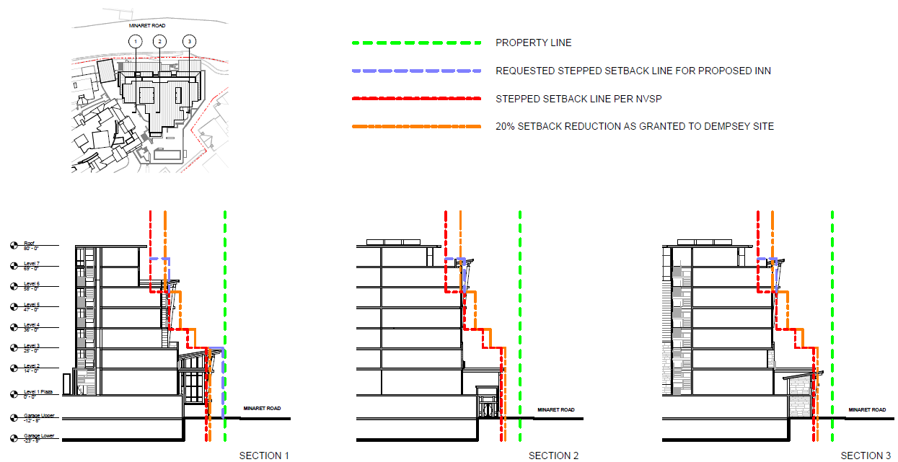
Minaret Road Setback Analysis, Sheet 18-4
Notes:
Only ped overhang and 6th floor

Slide 32
Density Analysis
Proposed density of 72 rooms/acre and not counting commercial s.f. towards density is consistent with the North Village District Planning Study
Transfer of 30 rooms from Mammoth Crossing
  Transfer would not result in an increase in overall density under General Plan or NVSP
  Transfer would move rooms closer to the Village plaza, gondola, and transit hub
Proposed density would not result in significant impacts, including traffic, water supply, or other public utilities or services

Slide 33
District Zoning Amendment Findings
Consistent with the General Plan
  Implements NV District Character, discourages monotony, no increased public view impacts
Internally consistent with the NVSP
  Implements NVSP objectives, vertical expression, varied skyline
Will not be detrimental to the public interest, health, safety, convenience, or welfare of the town
  SEIR found no significant impacts (air quality, hazards, traffic, noise, public services, etc.)
In compliance with CEQA
  See SEIR findings
Site is physically suitable (design, location, shape, size, operating characteristics, and provision of public/emergency vehicle access and public services and utilities) for project
  Disturbed site, adjacent to Village, widened shoulder, adequate parking/services/utilities
Consistent with any applicable airport land use plan
  Airport ~8mi from project site, no impacts to airport

Slide 34
Tentative Tract Map, Use Permit, & Design Review

Slide 35
Parking
No change to vehicle access proposed
  Only 50 Fireside parking spaces exit onto Minaret Road
Valet parking proposed
  Valet parking would not interfere with 50 Fireside parking spaces
The project exceeds parking requirements by 6 spaces
MMSA parking agreement allows up to 50 MMSA cars to park on property owned by the 8050 property owner (e.g., 8050 or Mammoth Crossing sites); therefore, these 50 spaces not counted toward Inn/8050 parking obligations

Slide 36
Deliveries
Delivery trucks and vehicles access off of Canyon Blvd in the driveway area (3 driveway options - Final SEIR Attachment A, page 2-29)
Condition 29 requires a delivery operational plan that mandates that deliveries occur off of Canyon Blvd in porte cochere or driveway and staff to manage traffic during deliveries

Slide 37
Project Design
Project design reflects Advisory Design Panel (ADP) and Commission Design Committee review
Commission recommended design conditions of approval:
  40 – refinement of southeast building corner design detail
  41 – final building colors

Slide 38
Subdivision Map Act Findings
The map is consistent with General Plan and NVSP
  Implements NV District Character, implements NVSP objectives
Design and improvements are consistent with General Plan
  NVSP design and development standards implement General Plan; project conforms to these standards with DZA approval
The site is physically suitable for the type of development
  Already developed site, planned for lodging use, adequate delivery/valet/snow management
The site is physically suitable for the proposed density of development
  Overall NVSP density not exceeded, adequate public services/utilities
The design of the subdivision and the proposed improvements are not likely to cause substantial environmental damage nor substantially injure fish or wildlife or their habitat
  Dept. Fish & Wildlife determined no effect on fish, wildlife, or their habitat
The design and improvements are not likely to cause serious public health problems
  SEIR found no significant impacts (air quality, hazards, traffic, noise, public services, etc.)
The project will not conflict with public easements for access through or use of project site
  All easements on TTM or required by conditions, all utility easements in place or can be extended

Slide 39
Use Permit Findings
Use is consistent with the General Plan
  A hotel use is consistent with NV District Character
Use is consistent with the Zoning Code
  The hotel use is allowed by NVSP, which supersedes Zoning Code
Use is consistent with the NVSP
  Hotels are allowed in the Resort General designation of the NVSP
Use will not be detrimental to the public health and safety nor materially injurious to properties or improvements in the vicinity
  SEIR found no significant impacts (air quality, hazards, traffic, noise, public services, etc.), conditions re deliveries, valet, signage, etc.
Other findings deemed necessary to support approval of the proposed use
  Housing will comply with future housing ordinance; project does not indiscriminately destroy trees

Slide 40
Design Review Findings (1 of 2)
Consistent with the Zoning Code and NVSP
  Consistent with NVSP design and development standards, which supersede Zoning Code; improved solar access to site, varied roof pitches, durable materials, landscape areas
Consistent with General Plan
  Improved solar access to site, architectural monotony discouraged, preserves all trees >6” dbh, landscaping, pedestrian amenities, no increased public view impacts
Consistent with Design Guidelines
  Street frontage improvements, building articulation, landscaping, no increased public view impacts, ADP support, conditions require further Commission Design Committee review
Site and building design combine in an attractive/visually cohesive manner, compatible with and complements the desired architectural/aesthetic character of the area and a mountain resort community, encourages ped activity, and promotes neighboring uses compatibility
  Unique design expressive of modern mountain architecture, pedestrian amenities, connection to 8050A and B, shared parking maintained
Streetscape design consistent with commercial districts character and residential neighborhoods
  Streetscape improvements – landscaping, pocket park, permanent heat traced sidewalk

Slide 41
Design Review Findings (2 of 2)
Parking implements the planned mobility system; buffer surrounding land uses; minimize visibility; prevent conflicts between vehicles/peds/cyclists; minimize storm water run-off and heat-island effect; achieve a safe, efficient, and harmonious development
  Valet parking, landscaping and streetscape improvements to improve garage aesthetics and buffer, bicycle parking, lot coverage does not exceed allowed to minimize run-off
Down-directed and shielded lighting complement buildings, are of appropriate scale, provide adequate light over walkways and parking areas to create a sense of pedestrian safety, minimize light pollution and trespass, and avoid creating glare
  Lighting will complement building design and will comply with lighting ordinance
Landscaping conserves water, promotes a natural aesthetic, and is compatible with and enhances the architectural character and features of the buildings on site, and helps relate the building to the surrounding landscape
  Landscaping will use less water than allowed, landscaping to relate building to surroundings
Consistent with any approved tentative map, use permit, variance, or other planning or zoning approval the project required
  Consistent since being processed concurrently

